Slide 1
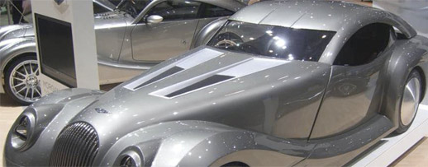




Slide 2
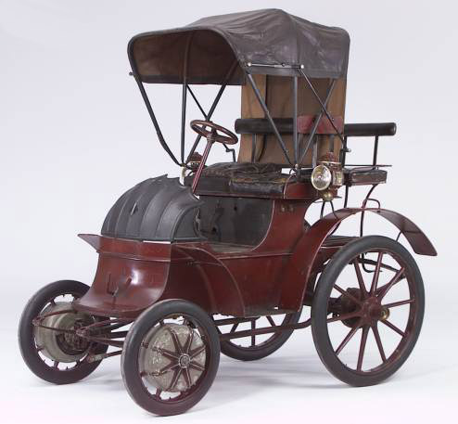



Slide 3



Slide 4
OVEM+
OVEM+

